Slide 1
CHAPTER 6: SYNCHRONIZATION – ĐỒNG BỘ

Slide 2
Contents
Clock synchronization
Logical clock
Mutual exclusion
Election algorithm

Slide 3
Synchronization
How process synchronize
Multiple process to not simultaneously access to the same resources: printers, files
Multiple process are agreed on the ordering of event.
Ex: message m1 of P is sent after m2 of Q
Synchronization based on actual time
Synchronization by relative ordering

Slide 4
1. Clock Synchronization
Notion of synchronization
Physical Clocks
Global Positioning System
Clock Synchronization Algorithms
Use of Synchronized Clocks

Slide 5
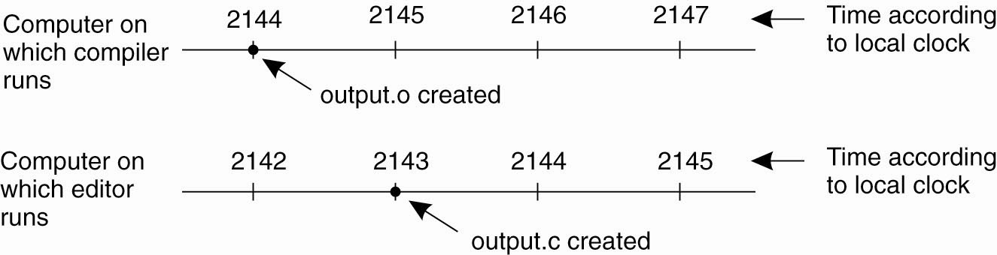

Why do we need it?
Example 1: Programming
When each machine has its own clock, an event that occurred after another event may nevertheless be assigned an earlier time.

Slide 6
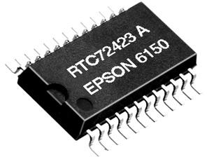
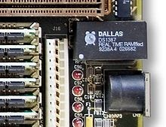

Physycal Clocks
Timer
Counter & Holding register
Problem in distributed systems:
How do we synchronize them with real-world?
How do we synchronize the clocks with each other?
RTC IC
(Real Time Clock)

Slide 7
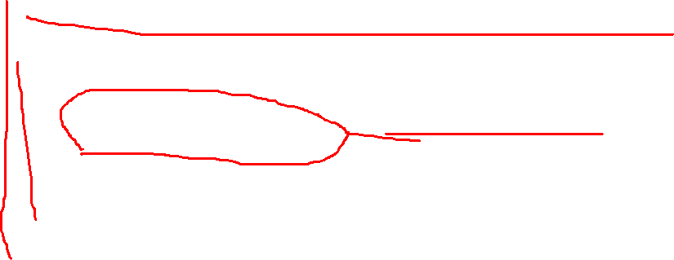
Clock Synchronization Algorithms
Network Time Protocol
Berkeley Algorithm
Clock Synchronization in Wireless Networks

Slide 8
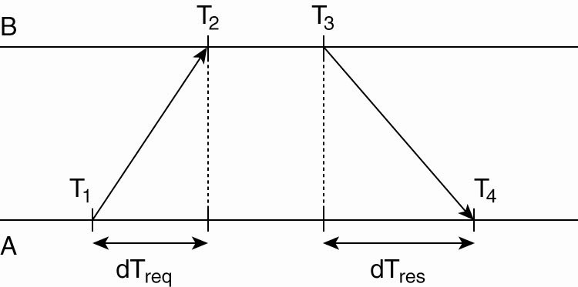

Network Time Protocol
Getting the current time from a time server

Slide 9
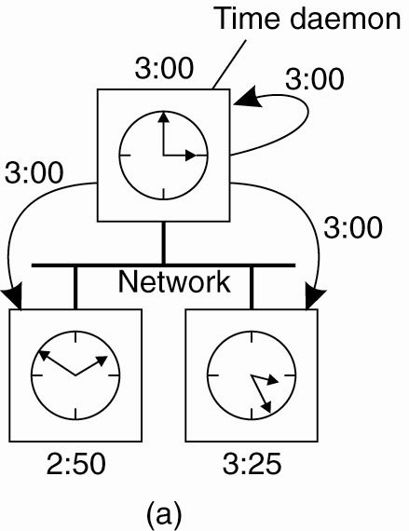
The Berkeley Algorithm (1)
The time daemon asks all the other machines for their clock values.

Slide 10
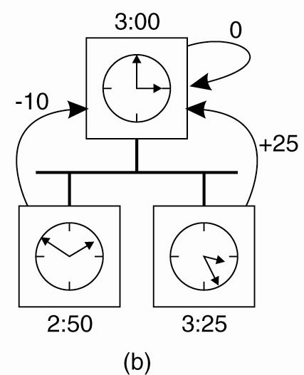

The Berkeley Algorithm (2)
The machines answer.

Slide 11
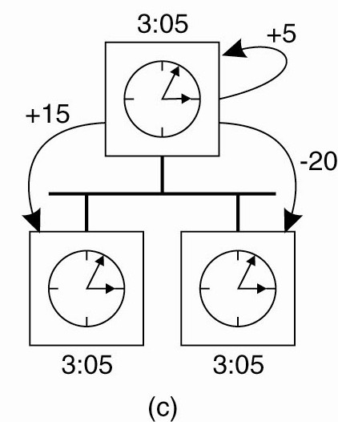

The Berkeley Algorithm (3)
The time daemon tells everyone how to adjust their clock.

Slide 12
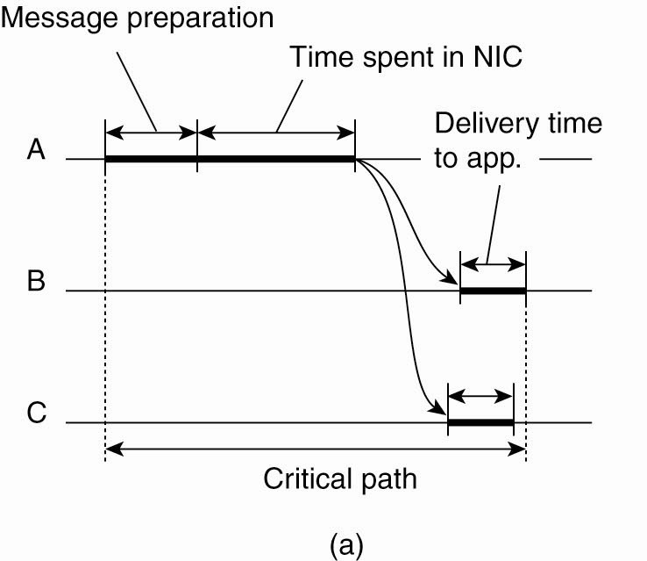
Clock Synchronization in Wireless Networks (1)
The usual critical path in determining network delays.

Slide 13
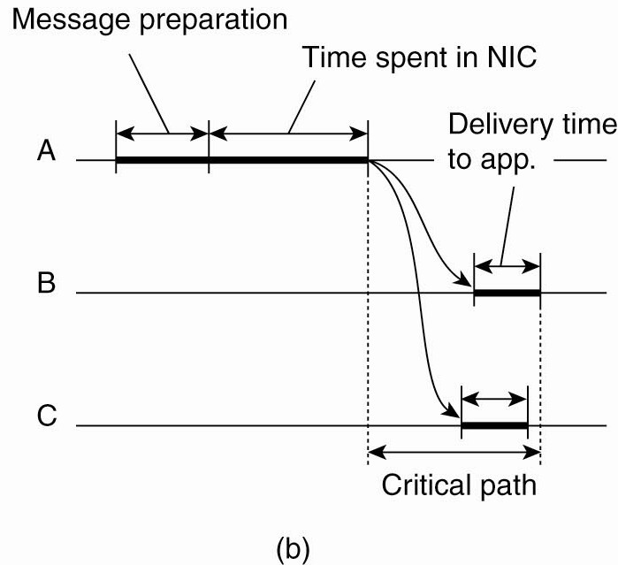

Clock Synchronization in Wireless Networks (2)
The critical path in the case of RBS (reference broadcast Synr).

Slide 14
2. Logical clock
Lamport logical clocks
Vector clocks

Slide 15

2.1. Lamport’s Logical Clocks (1)
The "happens-before" relation → can be observed directly in two situations:
If a and b are events in the same process, and a occurs before b, then a → b is true.
If a is the event of a message being sent by one process, and b is the event of the message being received by another process, then a → b
Transitive relation: a → b and b → c, then a → c
Concurrent

Slide 16
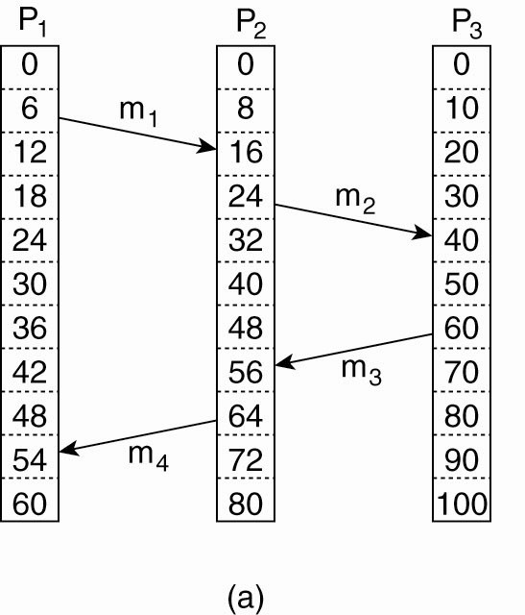
Lamport’s Logical Clocks (2)
Three processes, each with its own clock. The clocks run at different rates.

Slide 17
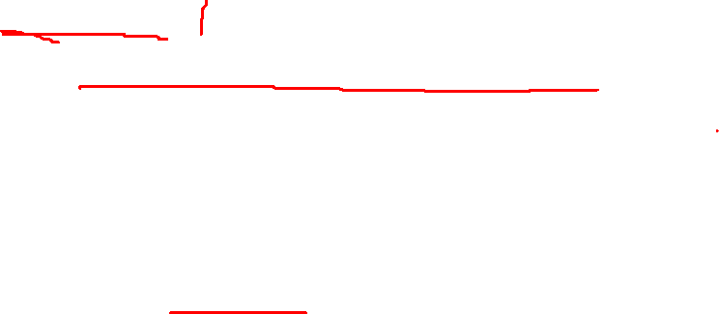
Lamport’s Logical Clocks (3)
Updating counter C_{i} for process P_{i}
Before executing an event P_{i} executes C_{i} ← C_{i} + 1.
When process P_{i} sends a message m to P_{j}, it sets m’s timestamp ts (m) equal to C_{i} after having executed the previous step.
Upon the receipt of a message m, process P_{j} adjusts its own local counter as
C_{j} ← max{C_{j} , ts (m)}, after which it then executes the first step and delivers the message to the application.

Slide 18
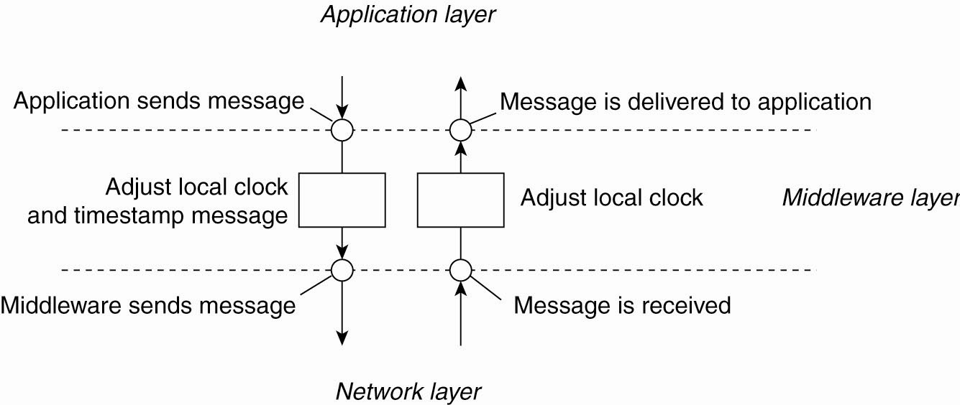
Lamport’s Logical Clocks (4)
Figure 6-10. The positioning of Lamport’s logical clocks in distributed systems.

Slide 19
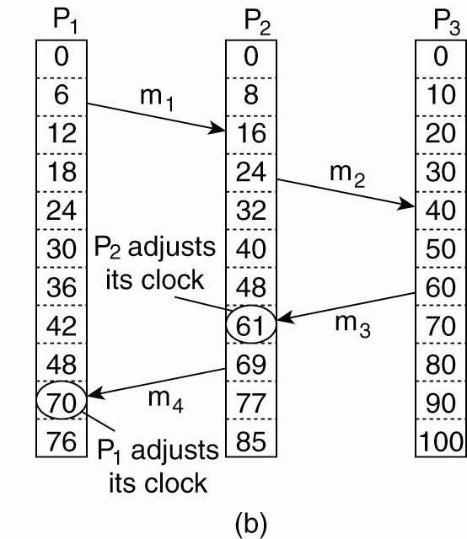
Lamport’s Logical Clocks (5)
(b) Lamport’s algorithm corrects the clocks.

Slide 20
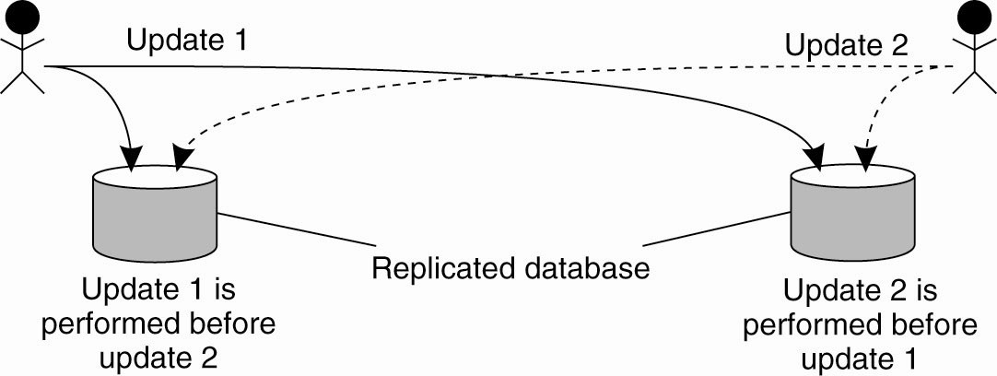
Example: Totally Ordered Multicasting
Updating a replicated database and leaving it in an inconsistent state.

Slide 21
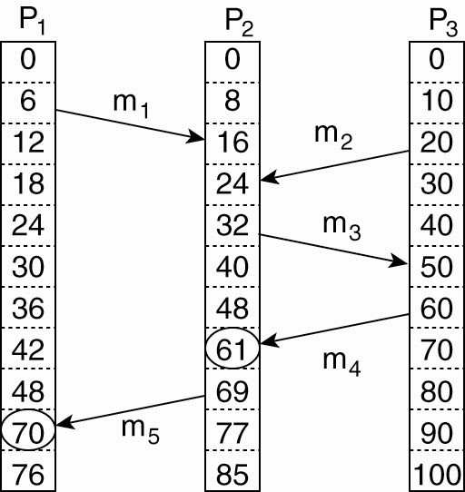
2.2. Vector Clocks (1)
Concurrent message transmission using logical clocks.

Slide 22
Vector Clocks (2)
Vector clocks are constructed by letting each process P_{i} maintain a vector VC_{i} with the following two properties:
VC_{i} [ i ] is the number of events that have occurred so far at P_{i}. In other words, VC_{i} [ i ] is the local logical clock at process P_{i} .
If VC_{i} [ j ] = k then P_{i} knows that k events have occurred at P_{j}. It is thus P_{i}’s knowledge of the local time at P_{j} .

Slide 23
Vector Clocks (3)
Steps carried out to accomplish property 2 of previous slide:
Before executing an event P_{i} executes VC_{i} [ i ] ← VC_{i} [i ] + 1.
When process P_{i} sends a message m to P_{j}, it sets m’s (vector) timestamp ts (m) equal to VC_{i} after having executed the previous step.
Upon the receipt of a message m, process P_{j} adjusts its own vector by setting
VC_{j} [k ] ← max{VC_{j} [k ], ts (m)[k ]} for each k, after which it executes the first step and delivers the message to the application.

Slide 24
3. Mutual exclusion
A Centralized Algorithm
A Decentralized Algorithm
A Distributed Algorithm
A Token Ring Algorithm
A Comparison of the Three Algorithms

Slide 25
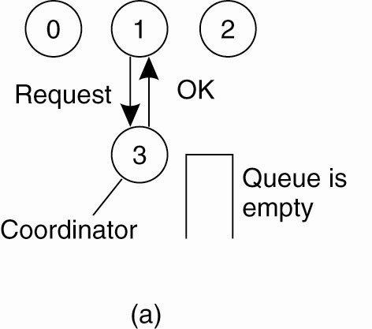
Mutual Exclusion
3.1. A Centralized Algorithm (1)
Process 1 asks the coordinator for permission to access a resource. Permission is granted.

Slide 26
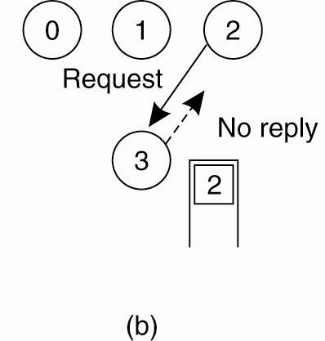
Mutual Exclusion
A Centralized Algorithm (2)
Process 2 then asks permission to access the same resource. The coordinator does not reply.

Slide 27
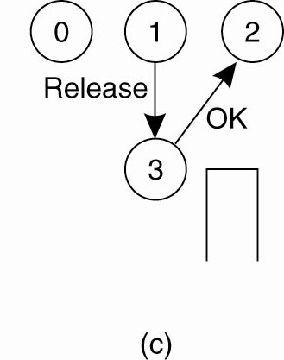
Mutual Exclusion
A Centralized Algorithm (3)
When process 1 releases the resource, it tells the coordinator, which then replies to 2.

Slide 28
3.2. A Distributed Algorithm (1)
Three different cases:
If the receiver is not accessing the resource and does not want to access it, it sends back an OK message to the sender.
If the receiver already has access to the resource, it simply does not reply. Instead, it queues the request.
If the receiver wants to access the resource as well but has not yet done so, it compares the timestamp of the incoming message with the one contained in the message that it has sent everyone. The lowest one wins.

Slide 29
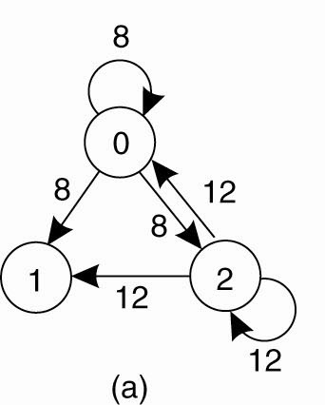
A Distributed Algorithm (2)
Two processes want to access a shared resource at the same moment.

Slide 30
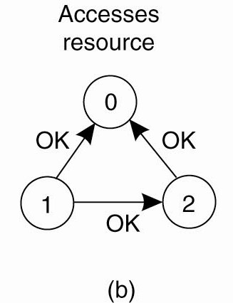
A Distributed Algorithm (3)
Process 0 has the lowest timestamp, so it wins.

Slide 31
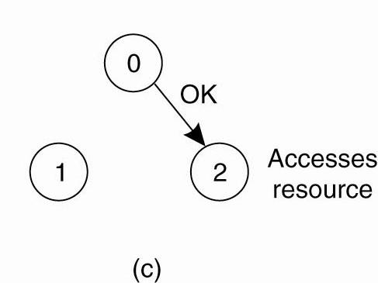
A Distributed Algorithm (4)
When process 0 is done, it sends an OK also, so 2 can now go ahead.

Slide 32
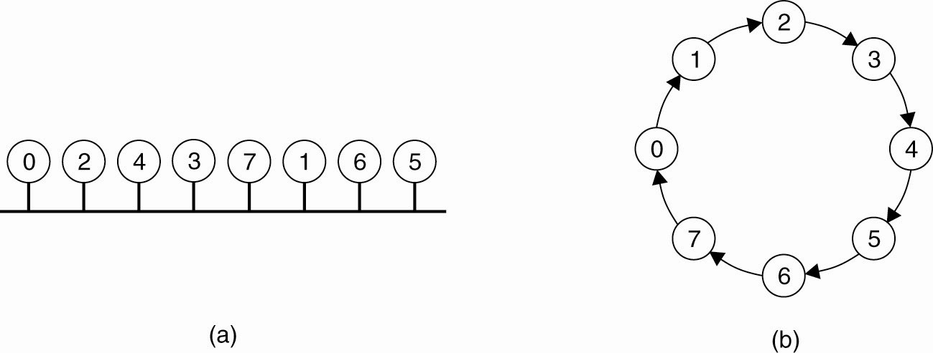
3.3. A Token Ring Algorithm
(a) An unordered group of processes on a network.
(b) A logical ring constructed in software.

Slide 33
Token Ring algorithm
Initialization
Process 0 gets token for resource R
Token circulates around ring
From P_{i} to P_{(i+1)}mod N
When process acquires token
Checks to see if it needs to enter critical section
P₀
If no, send token to neighbor
If yes, access resource
Hold token until done
P₅
P₁
P
t_{P}oken(R)
4
2
P₃

Slide 34
3. Election Algorithms
Traditional Election algorithms
The Bully Algorithm
A Ring Algorithm
Election in Wireless Environments
Election in Large-Scale Systems

Slide 35
Election Algorithms
The Bully Algorithm
P sends an ELECTION message to all processes with higher numbers.
If no one responds, P wins the election and becomes coordinator.
If one of the higher-ups answers, it takes over.
P’s job is done.

Slide 36
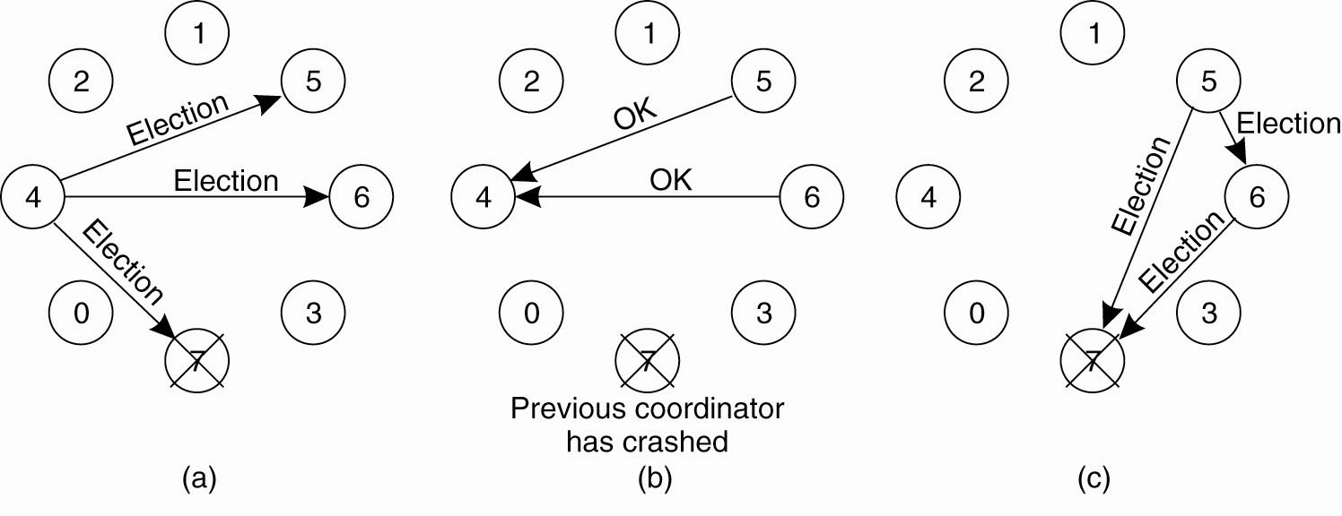
The Bully Algorithm (1)
The bully election algorithm.
(a) Process 4 holds an election.
(b) Processes 5 and 6 respond, telling 4 to stop.
(c) Now 5 and 6 each hold an election.

Slide 37
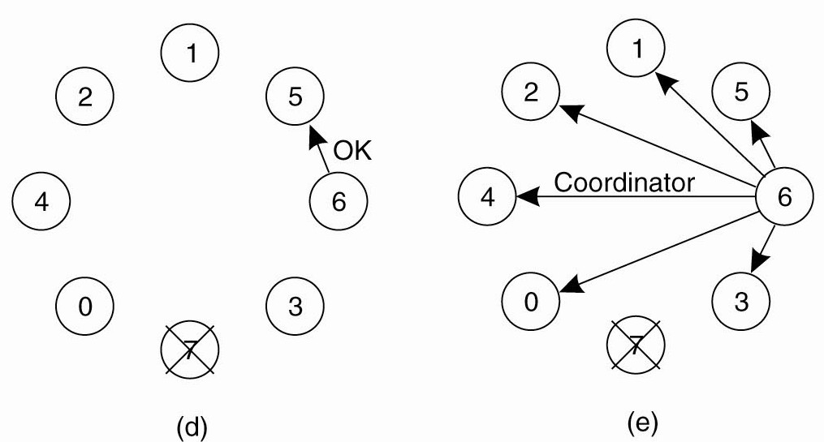
The Bully Algorithm (2)
The bully election algorithm. (d) Process 6 tells 5 to stop. (e) Process 6 wins and tells everyone.

Slide 38
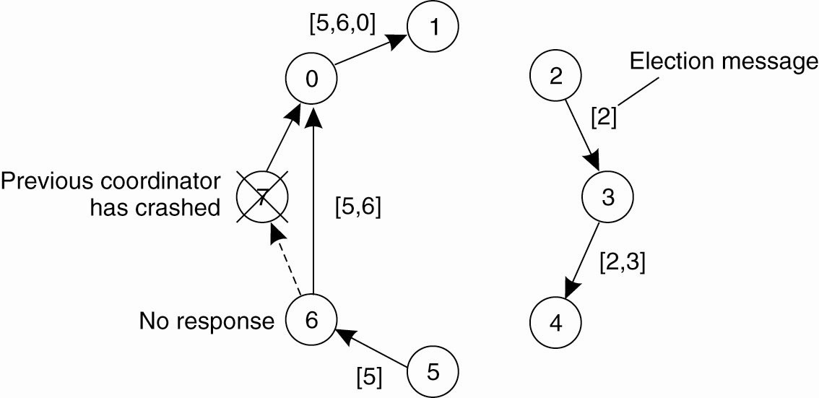
A Ring Algorithm
Election algorithm using a ring.

Slide 39
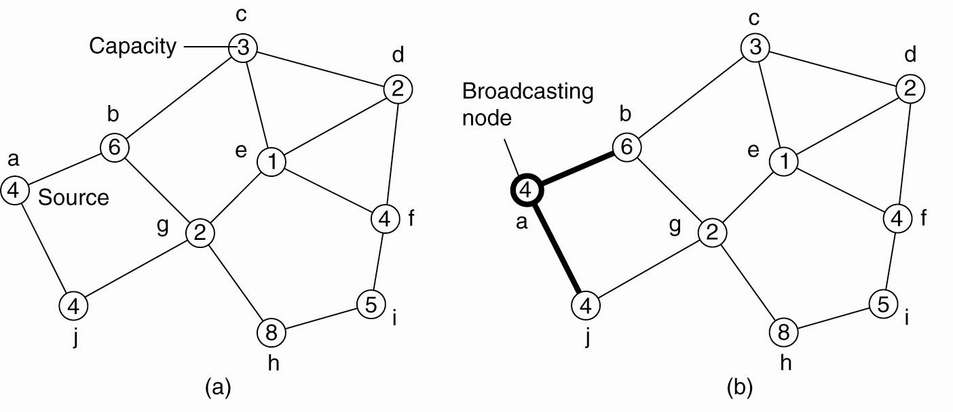
Elections in Wireless Environments (1)
Election algorithm in a wireless network, with node a as the source. (a) Initial network. (b)–(e) The build-tree phase

Slide 40
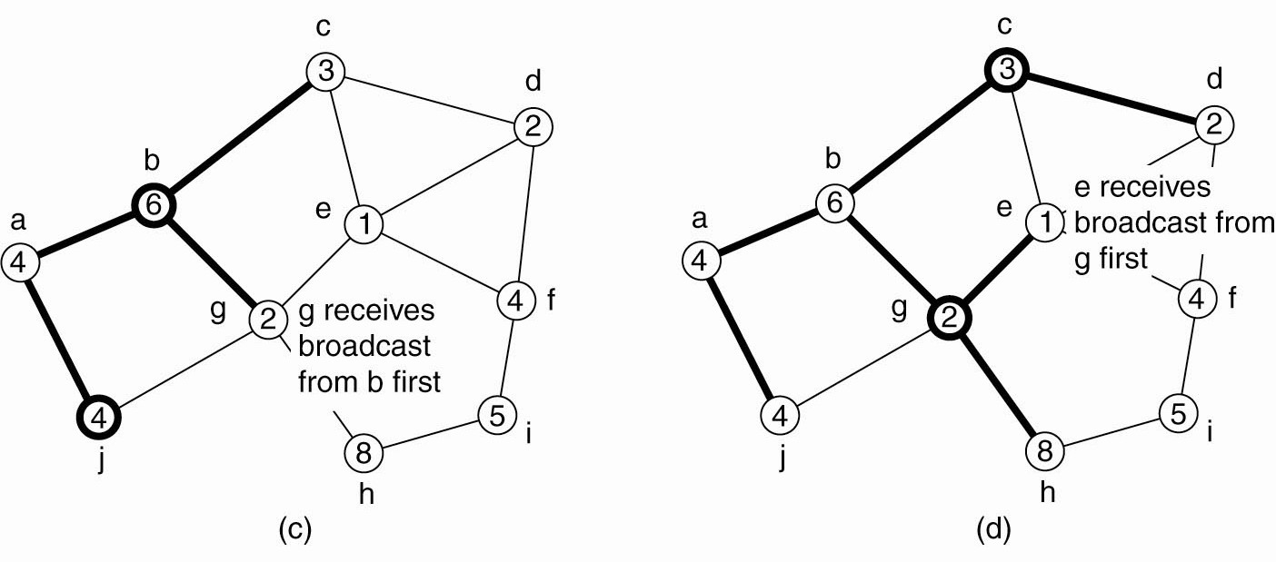
Elections in Wireless Environments (2)
Figure 6-22. Election algorithm in a wireless network, with node a as the source. (a) Initial network. (b)–(e) The build-tree phase

Slide 41
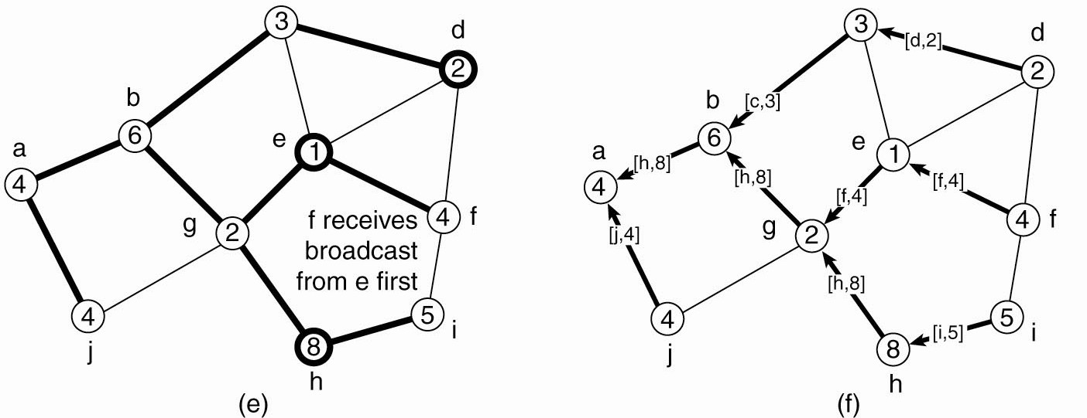
Elections in Wireless Environments (3)
(e) The build-tree phase.
(f) Reporting of best node to source.

Slide 42
Elections in Large-Scale Systems (1)
Requirements for superpeer selection:
Normal nodes should have low-latency access to superpeers.
Superpeers should be evenly distributed across the overlay network.
There should be a predefined portion of superpeers relative to the total number of nodes in the overlay network.
Each superpeer should not need to serve more than a fixed number of normal nodes.

Slide 43
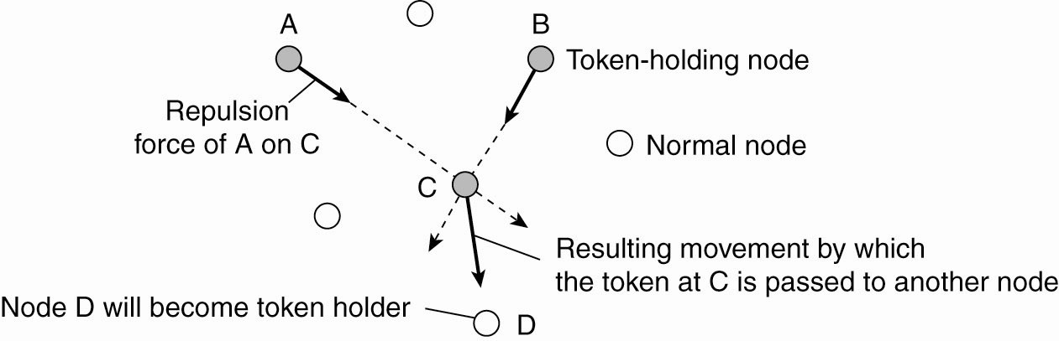
Elections in Large-Scale Systems (2)
Moving tokens in a two-dimensional space using repulsion forces.

